Slide 1
Project Presentation On “Flight Price Prediction”
Presented By: RAHUL M

Slide 2
Agenda:
Overview.
Problem Statement.
Problem Understanding.
What is Flight Price Prediction?
Importance of Flight price prediction.
Exploratory data analysis.
Visualizations.
Analysis.
Data cleaning steps.
Model Building.
Hyper Parameter Tunning.
Saving the model and predictions from saved best model.
Conclusion.

Slide 3
Overview:
In this particular presentation we will be looking on:
How to analyze the dataset of Flight Price Prediction.
What are the EDA steps in cleaning the dataset.
Overall analysis on the problem.
Model building from cleaned dataset.
Predicting Flight Price for saved best model.

Slide 4
Problem Statement:
Anyone who has booked a flight ticket knows how unexpectedly the prices vary. The cheapest available ticket on a given flight gets more and less expensive over time. This usually happens as an attempt to maximize revenue based on –
1. Time of purchase patterns (making sure last-minute purchases are expensive)
2. Keeping the flight as full as they want it (raising prices on a flight which is filling up in order to reduce sales and hold back inventory for those expensive last-minute expensive purchases)
So, you have to work on a project where you collect data of flight fares with other features and work to make a model to predict fares of flights.

Slide 5
Problem Understanding:
Flight prices are something unpredictable. It’s more than likely that we spent hours on the internet researching flight deals, trying to figure an airfare pricing system that seems completely random every day. Flight price appears to fluctuate without reason and longer flights aren’t always more expensive than shorter ones.
But now the question is how to know proper Flight price, for that I have built a Machine learning model which can predict the Flight price. Using various features like Airline, Source, Destination, Arrival time, Departure time, Stops, Travelling date and the Price for the same travel. So using all these previously known information and analysing the data I have achieved a good model that has 82% accuracy. So let’s understand what all the steps we did to reach this good accuracy.

Slide 6
What is Flight Price Prediction?
Nowadays, the number of people using flights has increased significantly. It is difficult for airlines to maintain prices since prices change dynamically due to different conditions. That’s why we will try to use machine learning to solve this problem. This can help airlines by predicting what prices they can maintain. It can also help customers to predict future flight prices and plan their journey accordingly.

Slide 7
Importance of Flight Price Prediction.
It is hard for the client to buy an air ticket at the most reduced cost. For this few procedures are explored to determine time and date to grab air tickets with minimum fare rate. The majority of these systems are utilizing the modern computerized system known as Machine Learning. The model guesses airfare well in advance from the known information. This framework is proposed to change various added value arrangements into included added value arrangement heading which can support to solo gathering estimation.

Slide 8
Exploratory Data Analysis:
As a first step I have scrapped the required data using selenium from makemytrip website.
And I have imported required libraries and I have imported the dataset which was in csv format.
Then I did all the statistical analysis like checking shape, nunique, value counts, info etc…..
While checking for null values I found there was a row full of null values in the dataset and I dropped that row as it will not help our analysis.
I have also droped Unnamed:0 column as I found it was the index column of csv file.
Next as a part of feature extraction I converted the data types of datetime columns and I have extracted usefull information from the raw dataset. Thinking that this data will help us more than raw data.

Slide 9
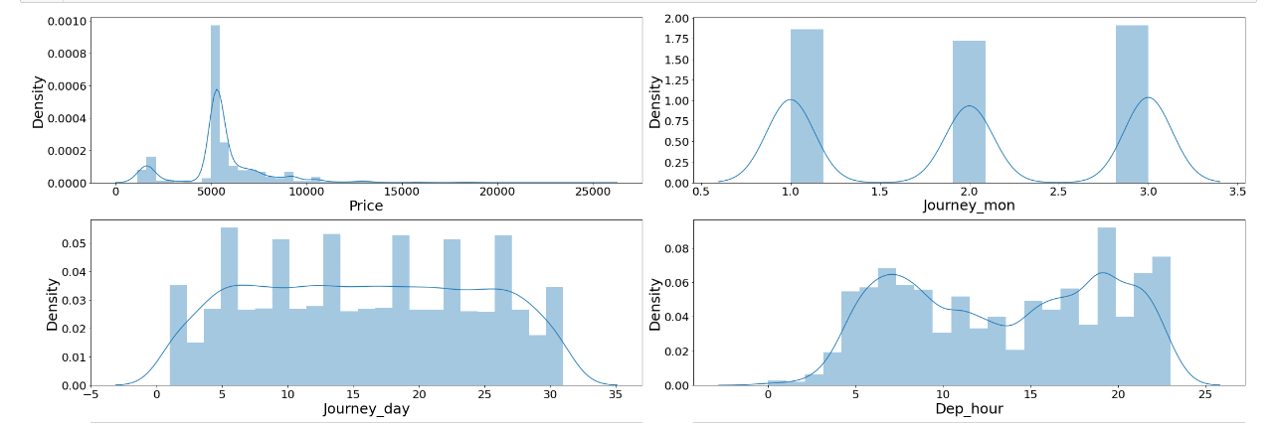
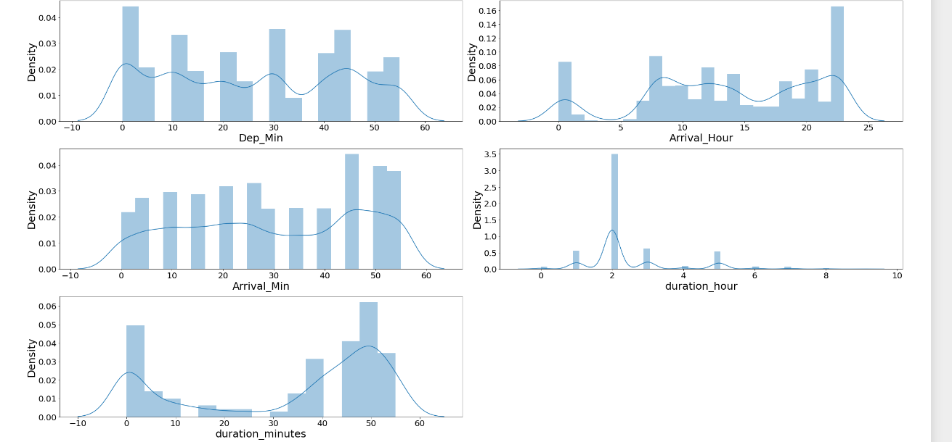
Univariate Visualization of numerical columns:

Slide 10
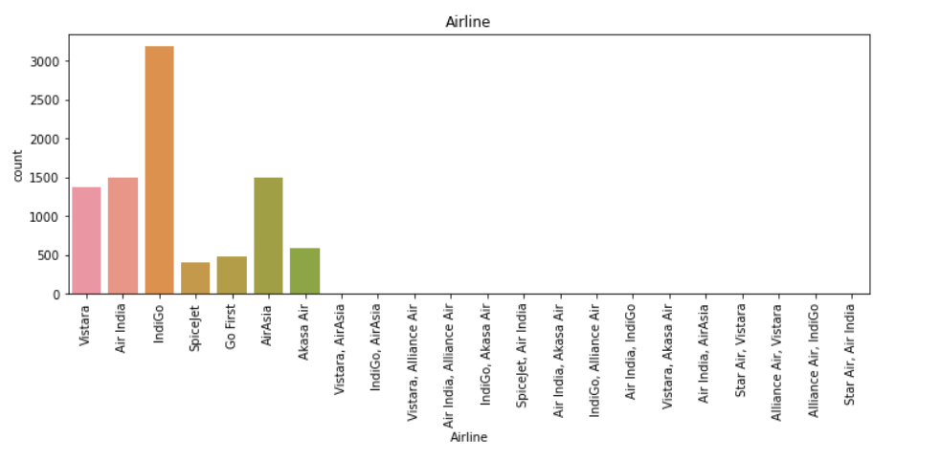
Univariate numerical columns:
There is skewness in durationminutes and durationhour in numerical columns.
Univariate Vizualization of Categorical columns:
Indigo has maximum count
The airlines
IndiGo has 3187 flights in the dataset
AirAsia has 1503 in the dataset
Air India has 1500 in the dataset
Vistara has 1368 in the dataset
Akasa Air has 585 in the dataset
Go First has 476 in the dataset
SpiceJet has 407 in the dataset
Alliance Air, Vistara has 11 in the dataset
IndiGo, AirAsia has 6 in the dataset
rest of the fights are having less than 4 flights

Slide 11
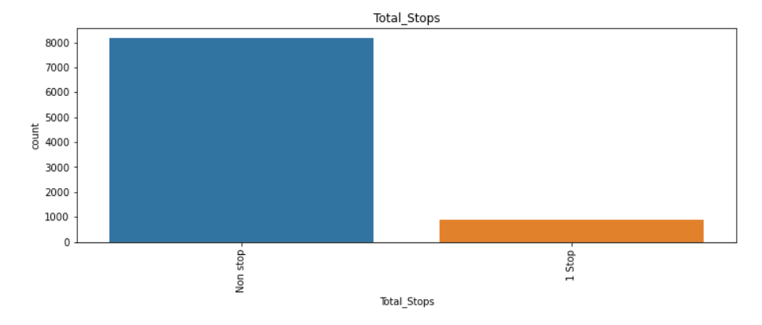
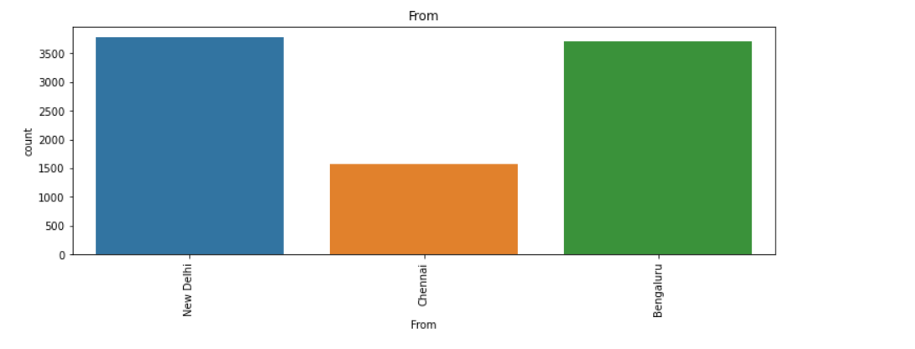
Univariate Vizualization of Categorical columns:
New Delhi has 3777 flights in the dataset
Bengaluru has 3708 flights in the dataset
Chennai has 1579 flights in the dataset
in the flights reaching New Delhi has 3708 flights in the dataset
Bengaluru has 5356 flights in the dataset

Slide 12
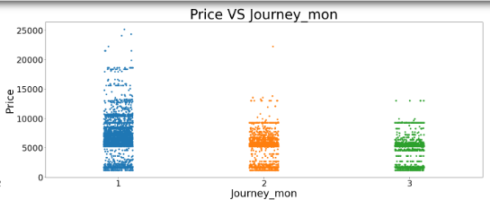
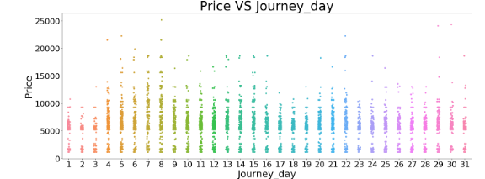
Bivariate Vizualization of numerical columns:
we are able to observe Higher prices in the initial months and reduction in prices as the months increases.
The price is increasing nearto 25000 in the month of january and
we can observe price reduction in month of feb and march months.
The difference in the prices in Feb and march are Not big in values.
We can observe higher prices in some days in the month and out of 31 days we can observe prices
reaching 10000 and more in some days and upto 25000.
in journey day 8 we can see the value reaching upto 25000 and near to these price in 29th and 30 of the months as well.

Slide 13
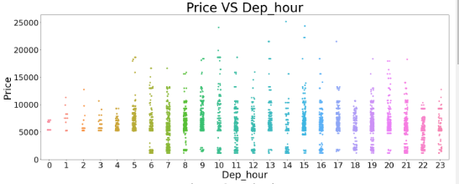
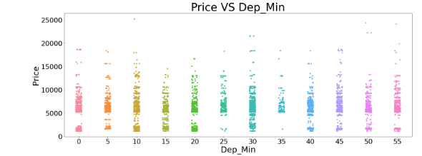
Bivariate Vizualization of numerical columns:
we can observe least price increment in the hour zero in the dataset and
in hour 10 and 14 and 15 it is reaching near to peak of 25000 as well.
From 6th hour to 23 we can observe the prices varying from min to max in the each hours.
We can observe less increase in the price in morning flights compared to flights past the morning hours
we can observe in the 10th and 5oth and 55th min the prices are reaching till the max values for flights upto 25000.
We can observe high data points in the price range of 5000 and 12000 for flights in the 5min intervals.

Slide 14
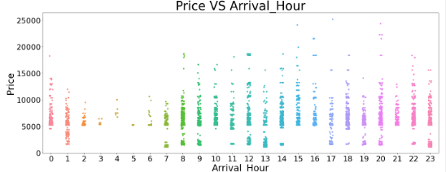
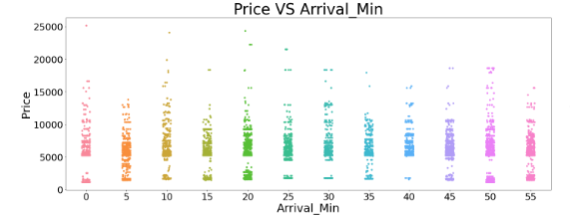
Bivariate Vizualization of numerical columns:
when the arrival hour is at hour zero,1,2,3,4,5,10,15,16,21 we can see higher flight prices for all flights in that day.
Except these hourse we can observe lowest fligjht price and the price reaching upto max as well in the flight hours other than thes as well
in 15th 17,20th hours we can observe the price reaching to highest for flights
Except the 5th min the flight prices are going Above 15000
and reaching 25000 as well for these minutes as well.

Slide 15
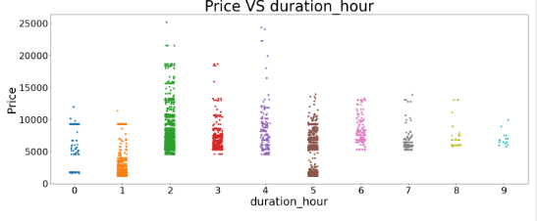
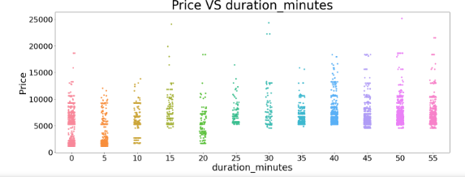
Bivariate Vizualization of numerical columns:
we can observe in the duration less than 2hours and more than 4 and less than 5 has the flight prices starting from least
We can observe the highest price increment in the duration hour of 2 and 4 has the highest for the flights in the datset.
when the duration is 9 we can see least increment in the prices for flights.
we can observe highest prices in the duration minute is at
15 and 30 and 50 for the flights.
the prices for flights start at the very least in the duration
of Zero and 5,10,20 they have the flughts with least prices.

Slide 16
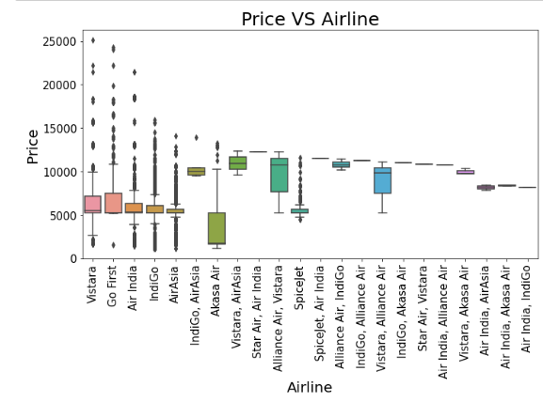
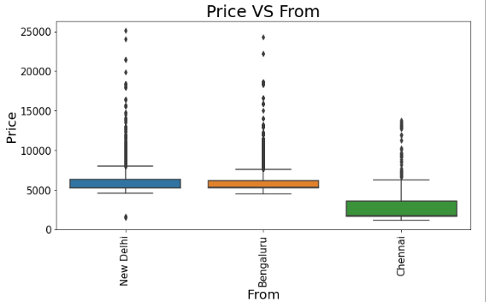
Bivariate Vizualization of categorical columns:
we can observe the flight prices are cheaper in chennai as the boarding station and
Highest in new delhi as the boarding station starting with smaller prices with few flights as well.
banglore is also having high prices for flights as well reaching near to 25000 as well.
we can observe the flight prices of chennai as the boarding station only reaching below 15000 increment
We can observe the Airlines Vistara,Go first ,Air India having the highest price increment for the flights in price.
we can observe the spice jet being cheaper than indigo for flight price in the Airlines.
we can observe the airlines vistara,Go first ,Air india,Indigo,Airasia,Akash Air having fligt prices starting at the very least.

Slide 17
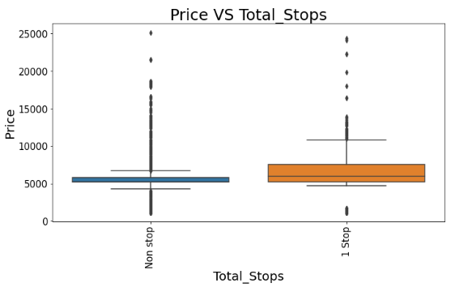
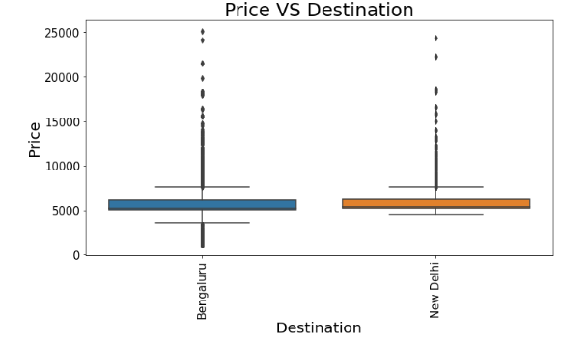
Bivariate Vizualization of categorical columns:
When the destination is banglore we can obsevre the highest price range reaching to 25000 and
starting with smaller prices for flights as well compared to new delhi as the Destination.
we can observe the flight prices for non stop increasing from the very least and max price for flights as well.
We ca observe fewe flight having price above 20000 in Non stop flights and
for the flights having single stops have few flights having price greater than 15000 in the datset.

Slide 18
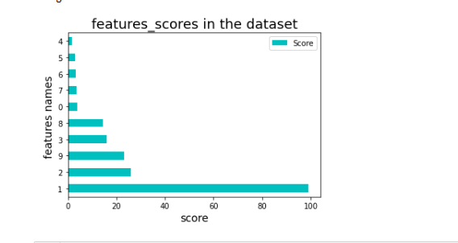
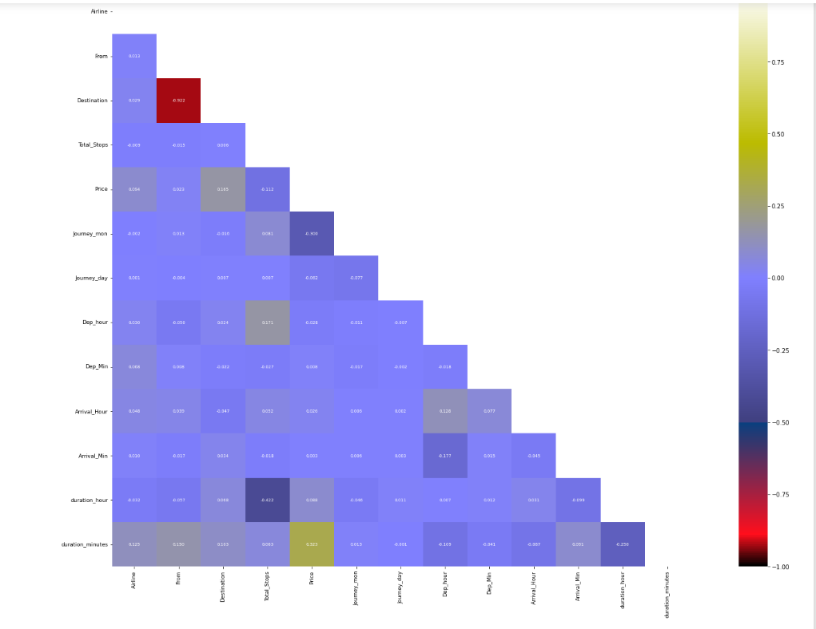
Heat Map

Slide 19
Analysis:
I have used dist plot to check the skewness in numerical columns.
I have used bar plot for each of categorical feature that shows the relation with the median flight price for all the sub categories in each categorical feature.
And also for continuous numerical variables I have used strip to show the relationship between continuous numerical variable and target variable.
I found that there is a linear relationship between continuous numerical variable and Flight Price.

Slide 20
Data Cleaning Steps:
Data has been scrapped from makemytrip website so we have to clean it for our convenience.
In my datasets I found there is no null values, but few ‘-’ and outliers and also skewness is present.
To encode the categorical columns I have use Label Encoding.
Use of Pearson’s correlation coefficient to check the correlation between dependent and independent features.
Also I have used standardization. Then followed by model building with all regression algorithms.

Slide 21
Model Building:
Since Price was my target and it was a continuous column with improper format which has to be changed to continuous float datatype column, so this perticular problem was Regression problem. And I have used all Regression algorithms to build my model. By looking into the r2 score and error values I found XGBRegressor as a best model with least difference between r2_score and Accuracy. Also to get the best model we have to run through multiple. Below are the list of Regression algorithms I have used in my project.
LinearRegression
RandomForestRegressor
XGBRegressor
ExtraTreesRegressor
AdaBoostRegressor
GradientBoostingRegressor
DecisionTreeRegressor
KNeighborsRegressor

Slide 22
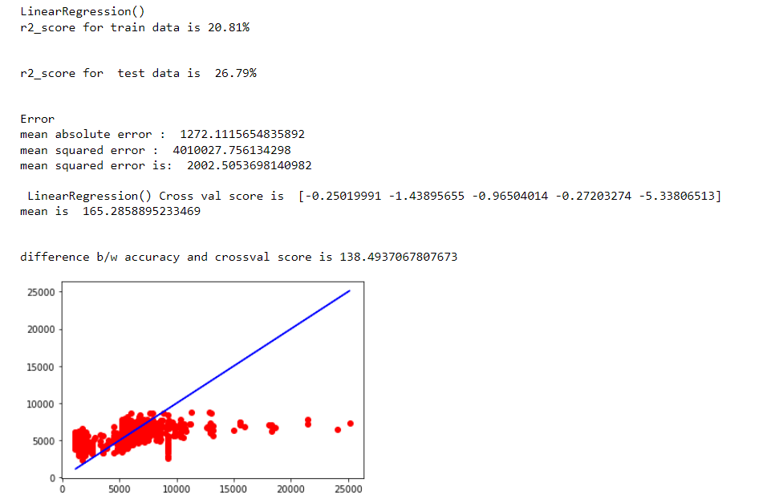
i) LinearRegressor:
LinearRegressor has given me 26.79% r2_score, we have to look into multiple models.

Slide 23
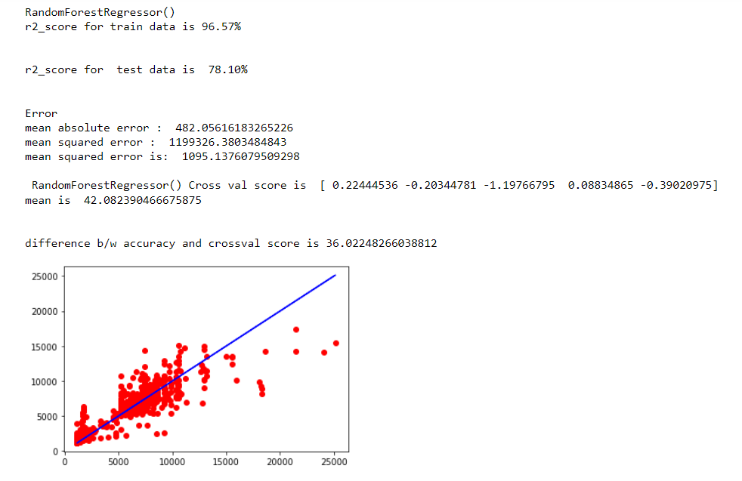
i) RandomForestRegressor:
RandomForestRegressor has given me 78.10% r2_score, but still we have to look into multiple models.

Slide 24
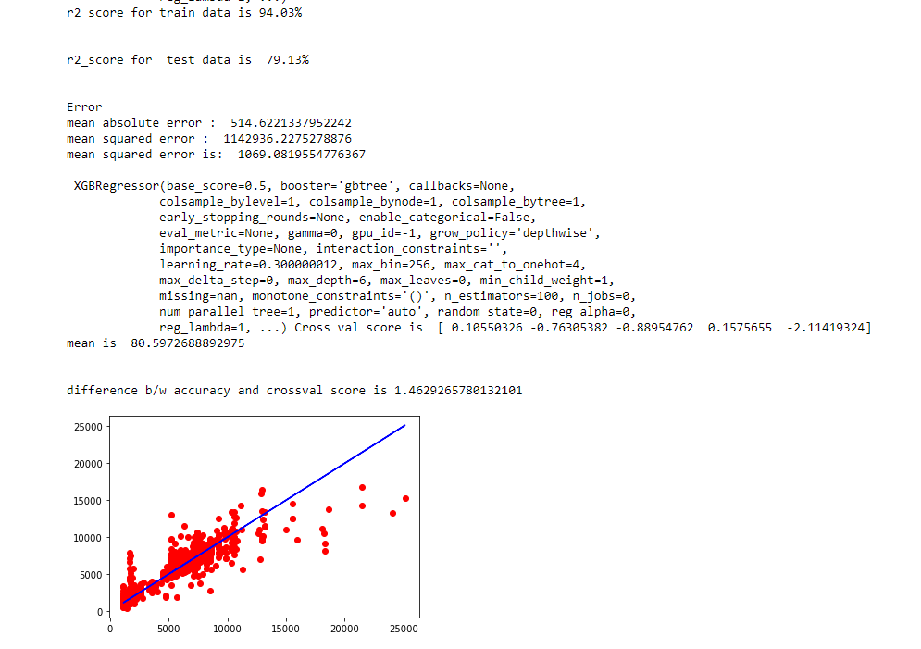
ii) XGBRegressor:
XGBRegressor is giving me 79.13% r2_score.

Slide 25
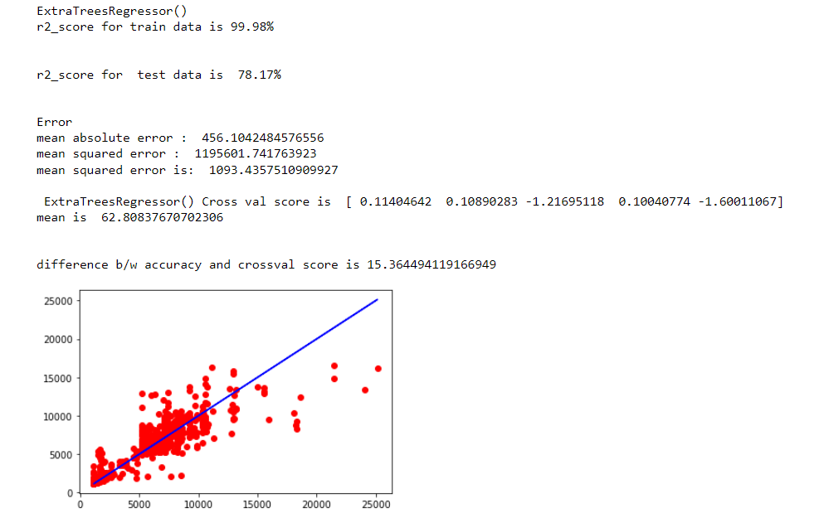
iii)ExtraTreesRegressor:
ExtraTreesRegressor is giving 78.17% r2_score.

Slide 26
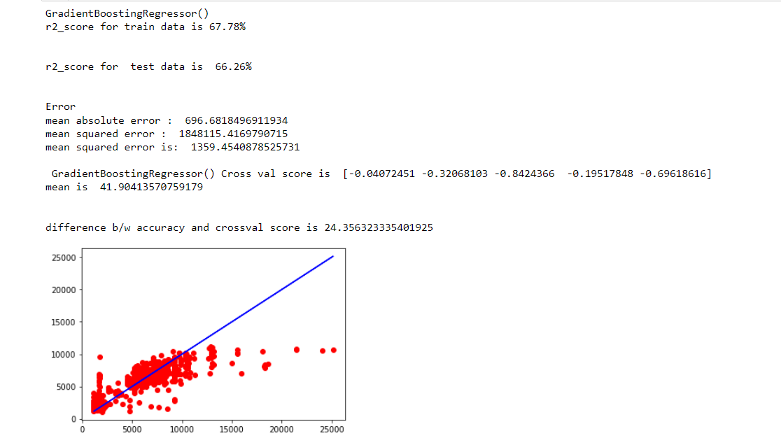
iv) GradientBoostingRegressor:
GradientBoostingRegressor is giving me 66.26% r2_score.

Slide 27
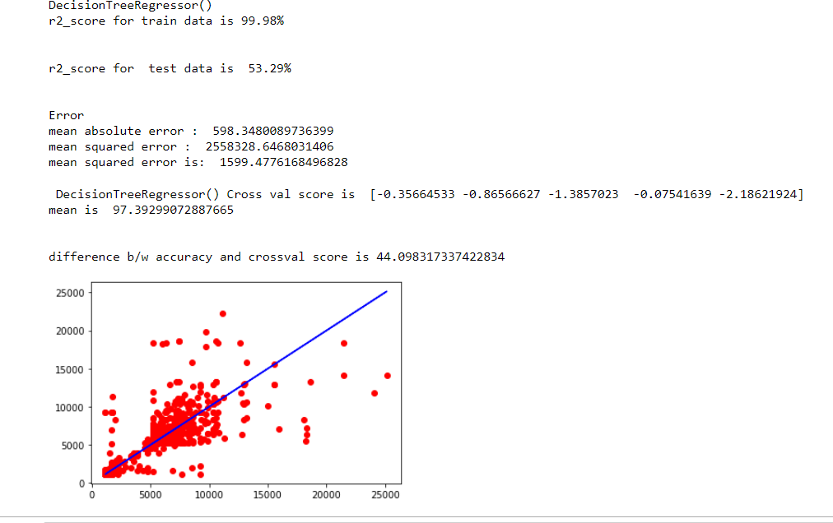
v) DecisionTreeRegressor:
DecisionTreeRegressor is giving me 53.29% r2_score.

Slide 28
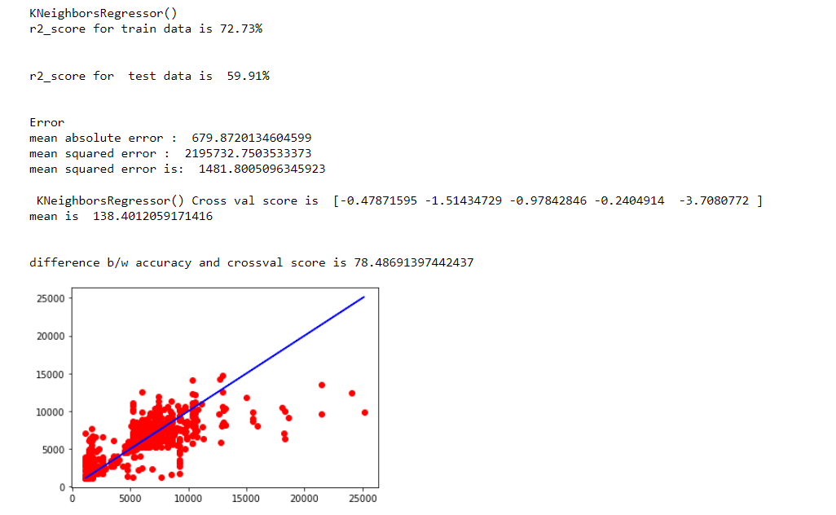
vi) KNN:
KNN is giving me 59.91% r2_score.

Slide 29
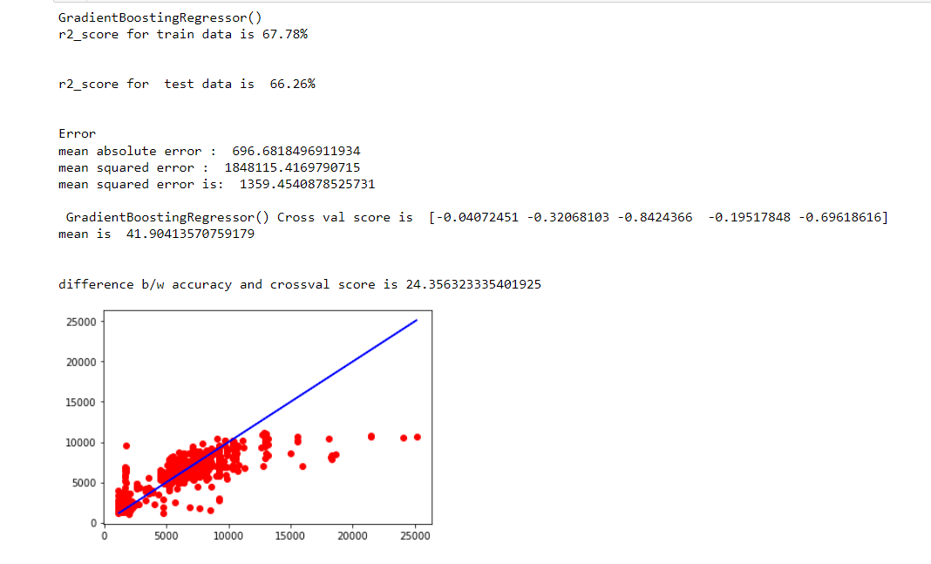
vii) AdaBoostRegressor :
By looking into the model r2_score and crossvalidation XGBRegressor as the best model with least difference between r2_score and cross validation score.

Slide 30
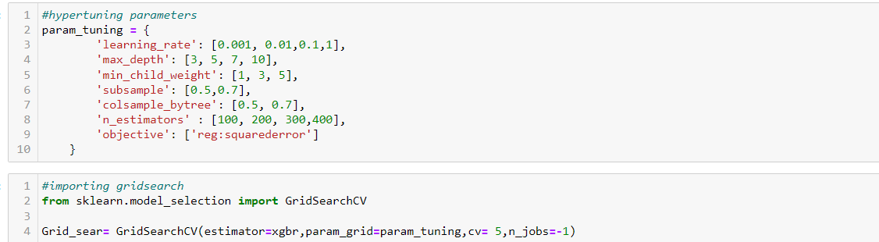
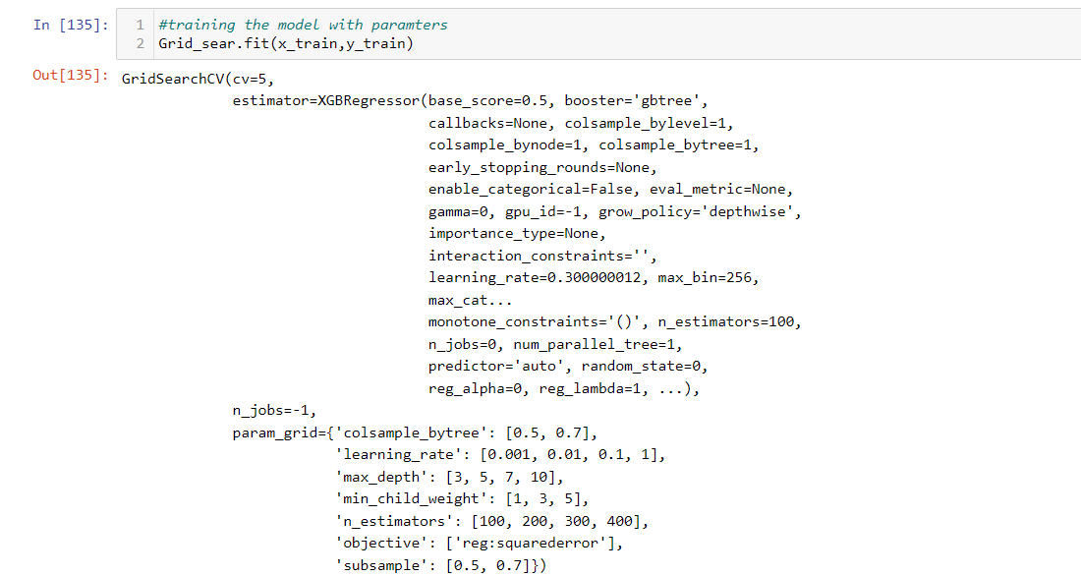
Hyper Parameter Tunning:

Slide 31
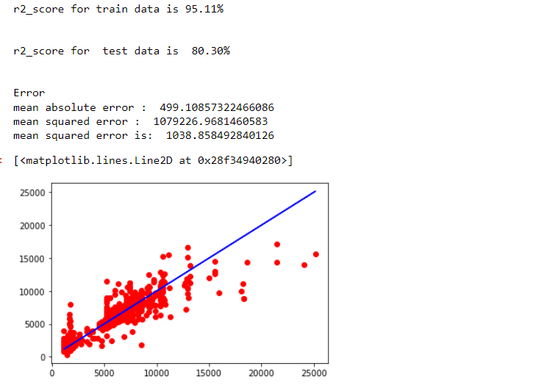
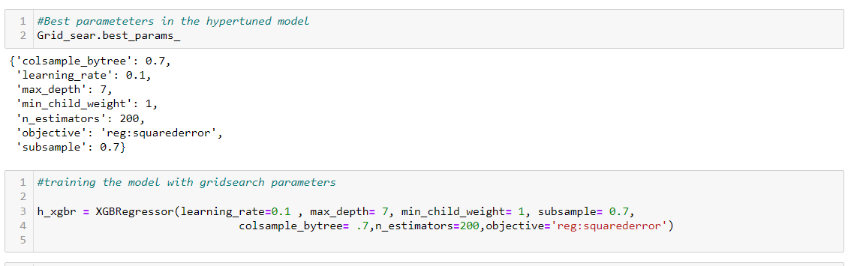
Hyper Parameter Tunning:
I have choosed all parameters of ExtraTreesRegressor, after tunning the model with best parameters I have incresed my model accuracy from 79.13% to 80.30%.

Slide 32
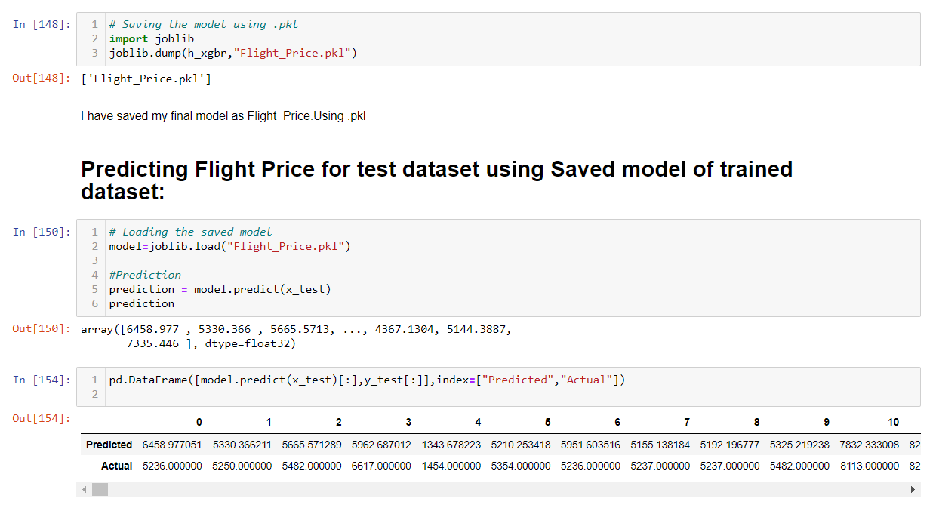
Saving the model and predictions using saved model:
I have saved my best model using .pkl as follows.
Now after saving the best model, loading my saved model and predicting the price values.
I have predicted the Flight Price using saved model, and the predictions look good.

Slide 33
Conclusion:
In this project report, we have used machine learning algorithms to predict the flight price. We have mentioned the step by step procedure to analyze the dataset and finding the correlation between the features.
Thus we can select the features which are correlated to each other and are independent in nature. The power of visualization has helped us in understanding the data by graphical representation it has made me to understand what data is trying to say.
Data cleaning is one of the most important steps to remove unrealistic values and unnecessary values.
These feature set were then given as an input to seven algorithms and a hyper parameter tunning was done to the best model and the accuracy has been improved. Hence we calculated the performance of each model using different performance metrics and compared them based on these metrics.
Then we have also saved the best model and predicted the flight price. It was good that the predicted and actual values were almost same.
To conclude, the application of machine learning in flight price prediction is still at an early stage. We hope this study has moved a small step ahead in providing some methodological and empirical contributions to online platforms, and presenting an alternative approach to the valuation of flight price.
Future direction of research may consider incorporating additional flight data from a larger economical background with more features.

